Slide 1
Living Organically at Farm7 - Taste the real taste
-Radical Farmer
Organic farming Made Easy

Slide 2
Outline
My Background
Farm7 History & Landscape
Building Process
Unbelievable Organic Results

Slide 3
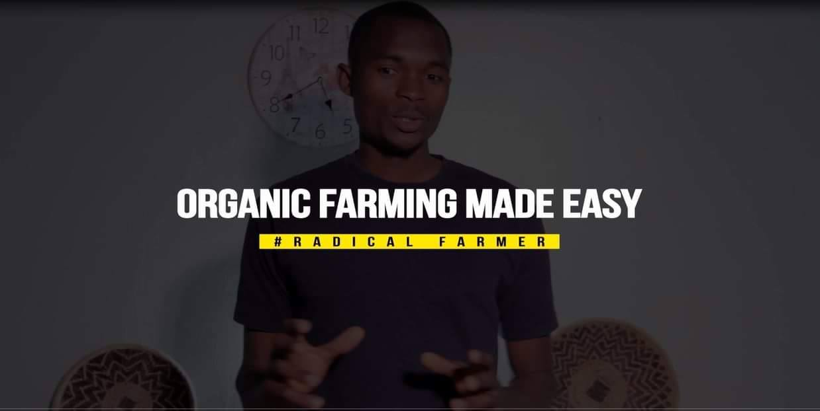
How Organic Farming Changed my life using local resources

Slide 4
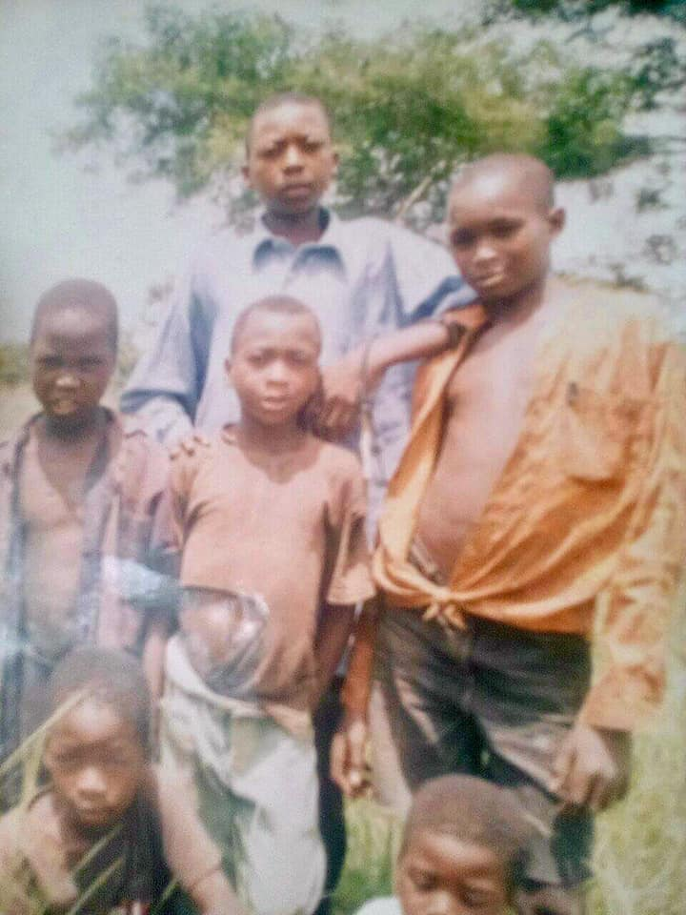
Our history, can’t limit what you can achieve, in life, circumstances should never be allowed to shape our future.
The history of farming can be transformed.

Slide 5
Farm7 History

Slide 6
Farm7 History

Slide 7
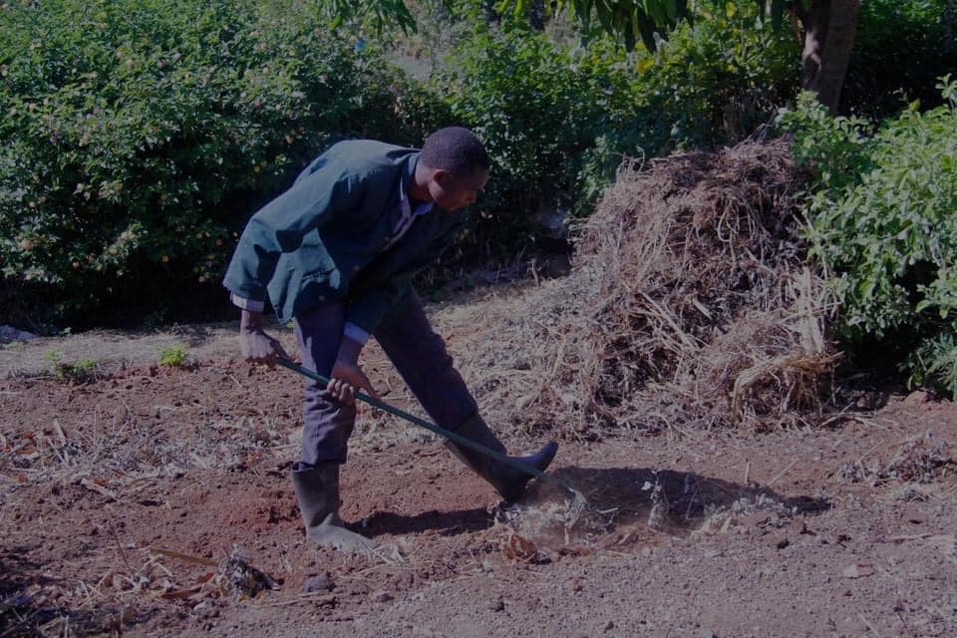
Farm7 History

Slide 8
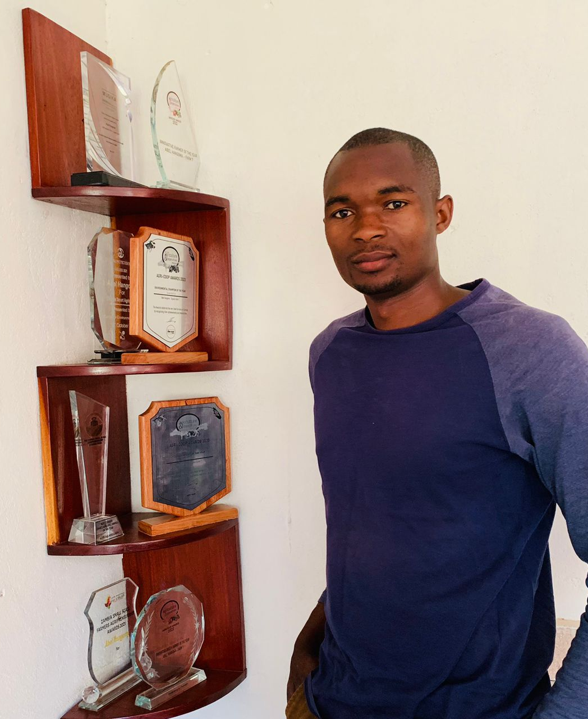

Slide 9
The history of farming can be transformed for beter, the future is clean and plain we have to write a new story.

Slide 10
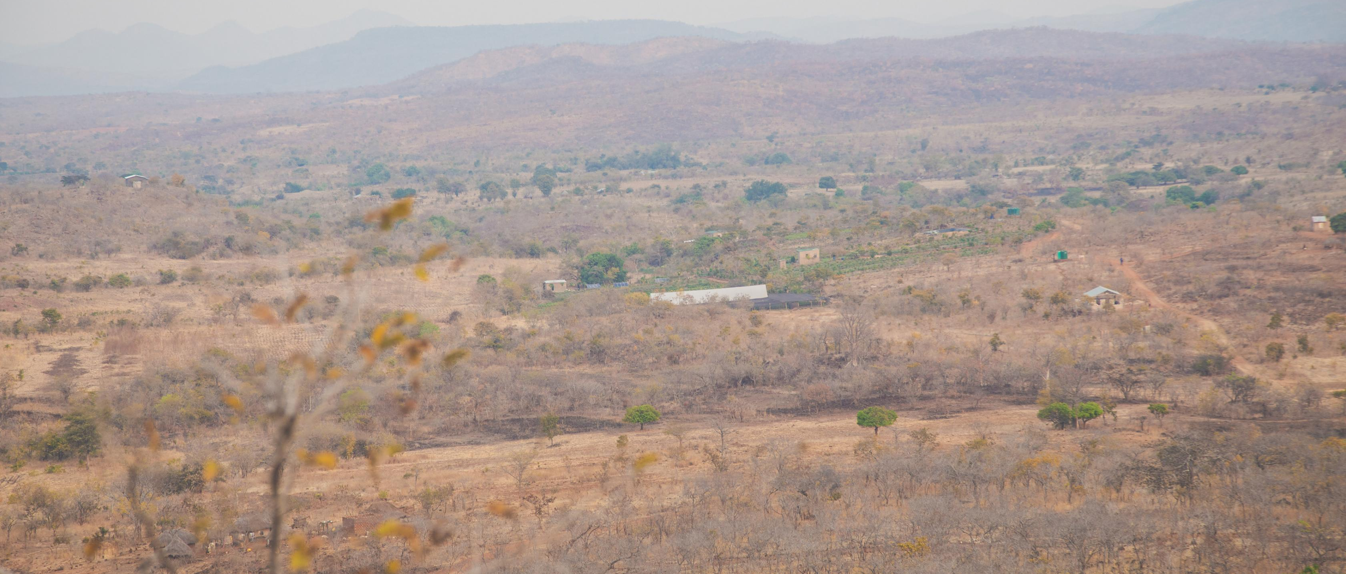
Farm7 History

Slide 11
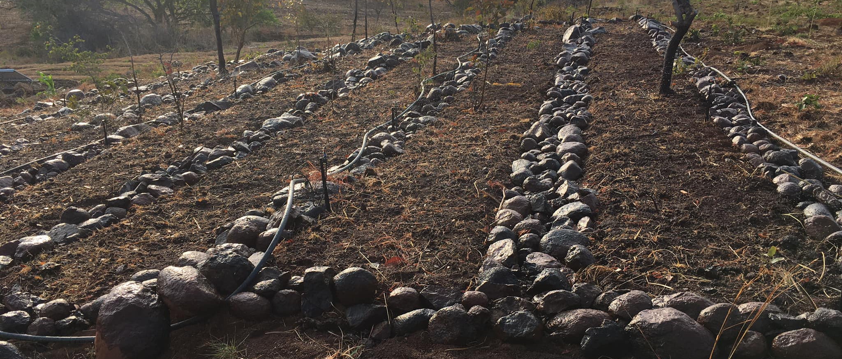
Farm7 History

Slide 12
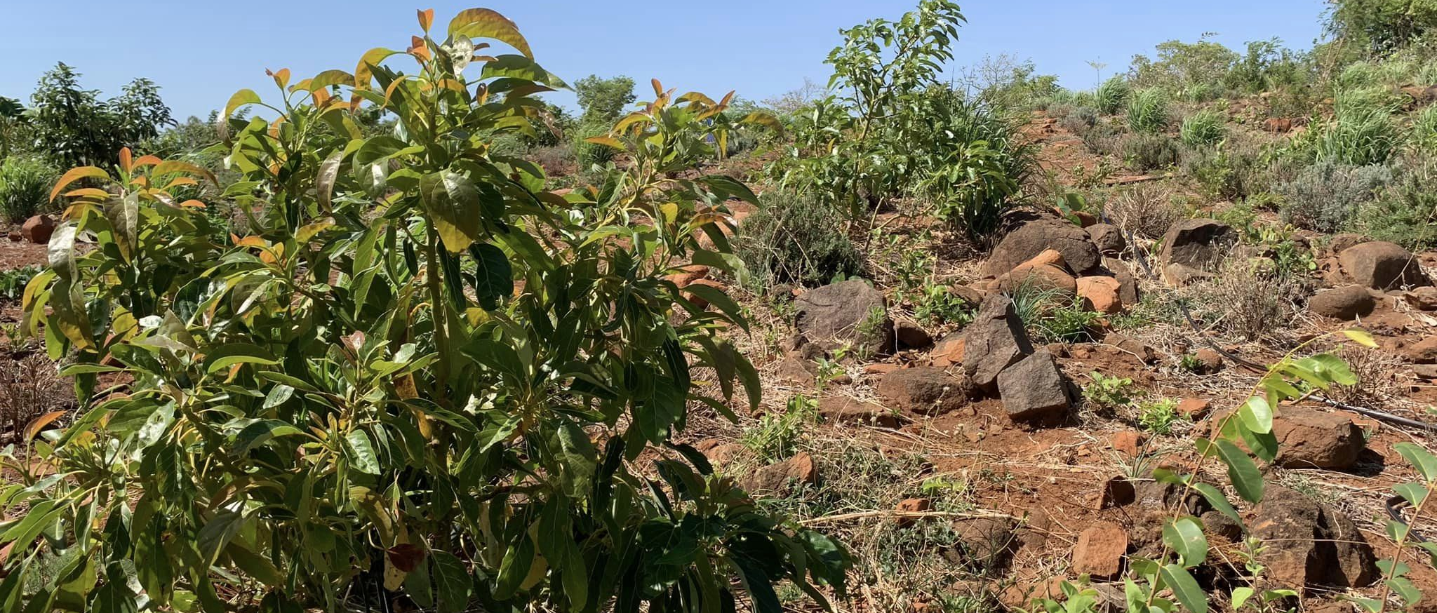
Farm7 History

Slide 13
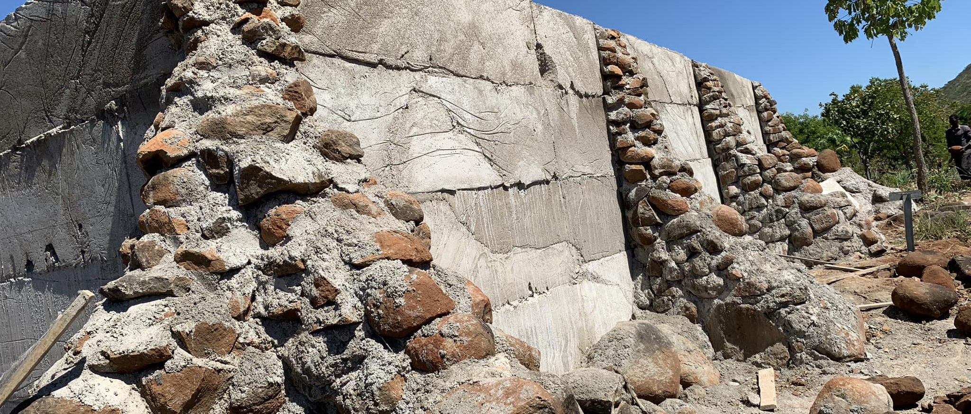
Farm7 History

Slide 14
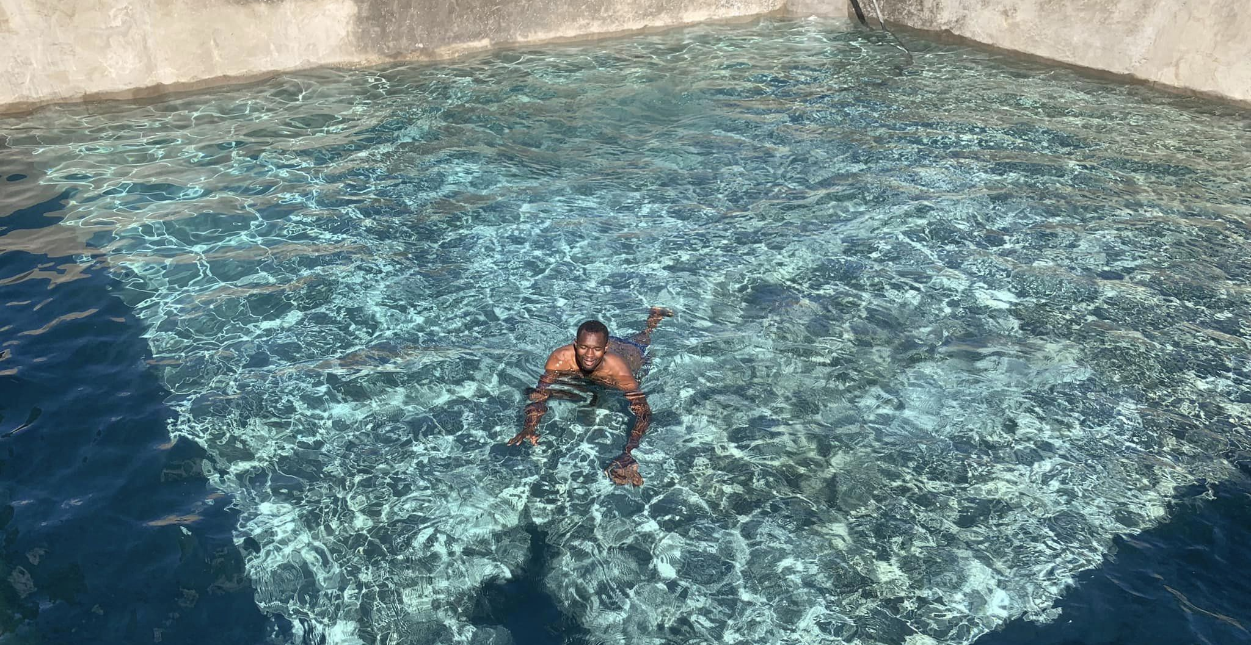
Built With Organic Materials half a Million Litters

Slide 15
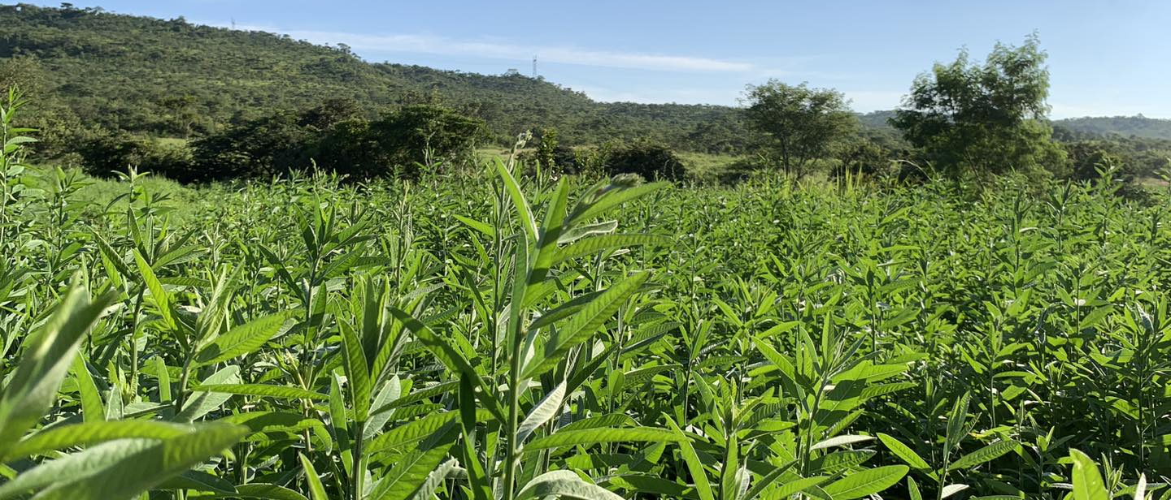
Building the Soil Organically

Slide 16
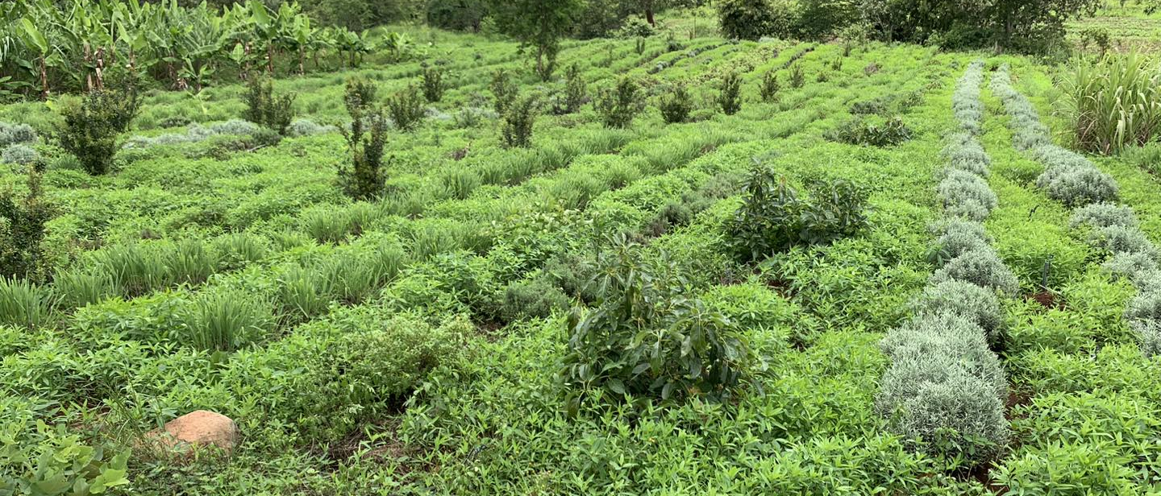
Building the Soil Organically

Slide 17
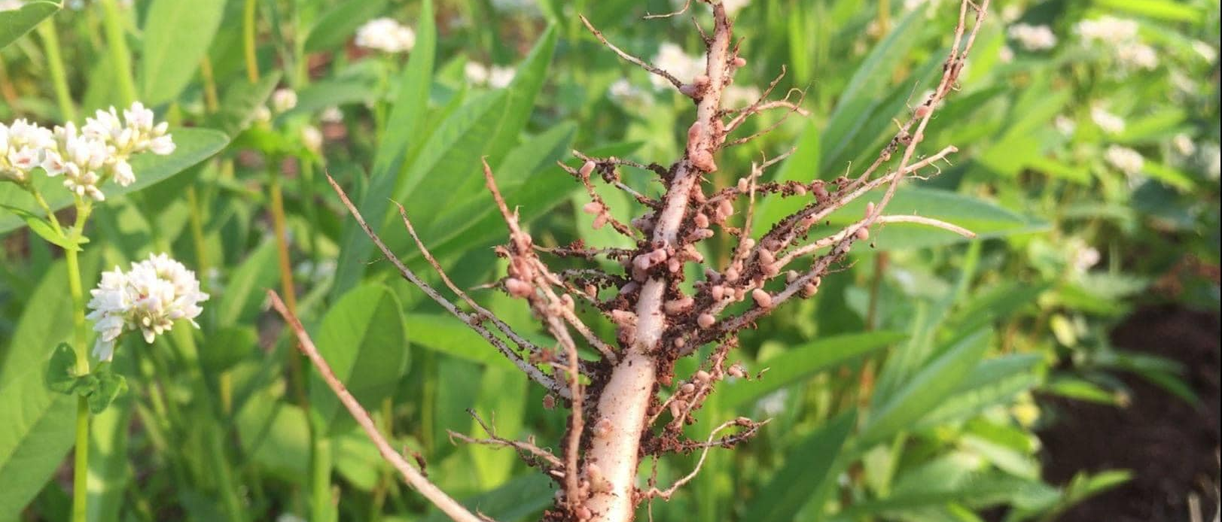
Building the Soil Organically

Slide 18
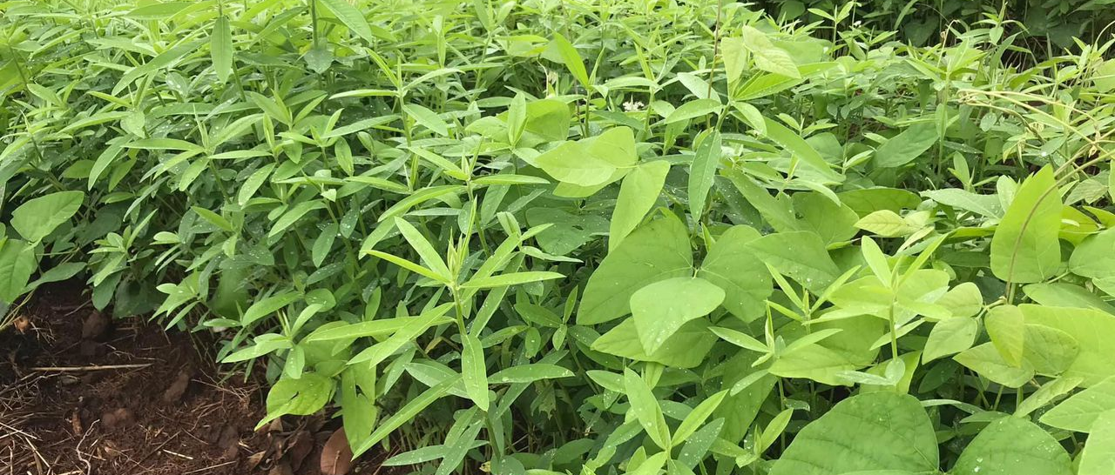
Building the Soil Organically

Slide 19
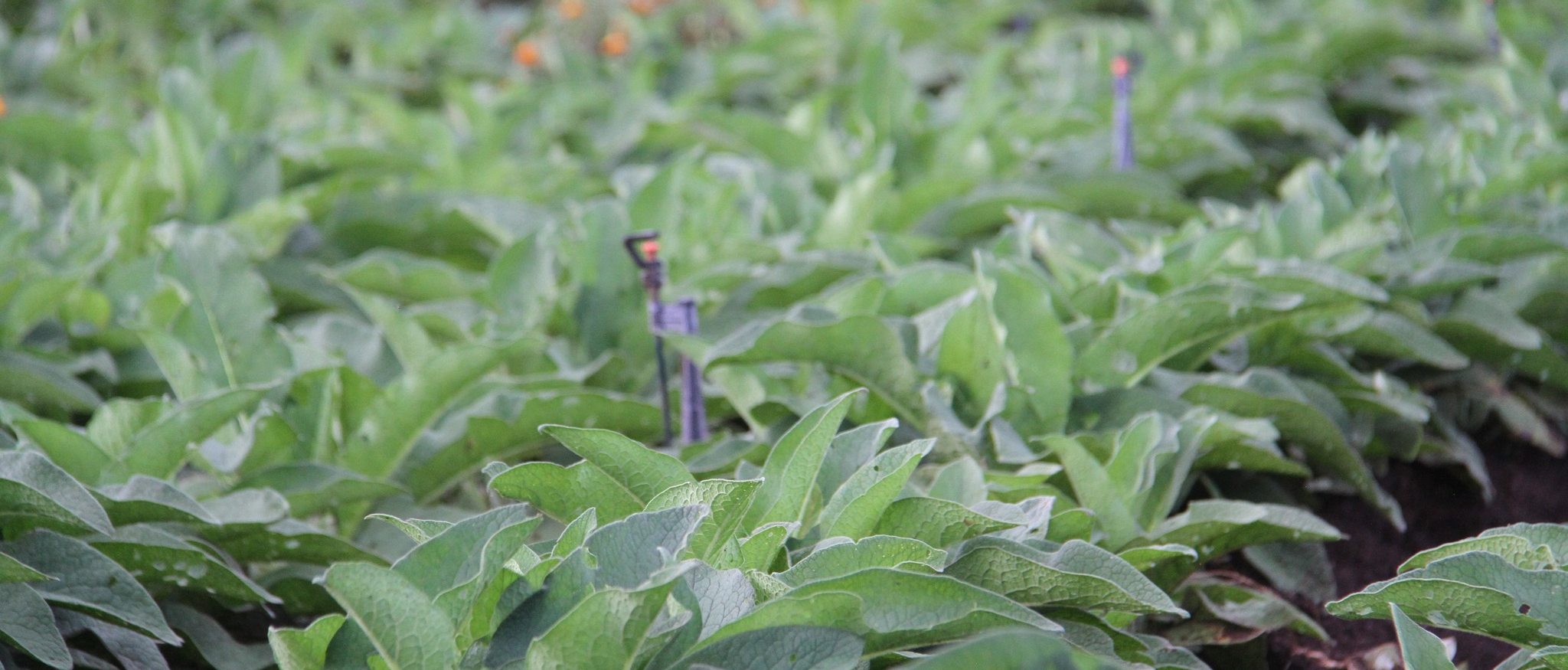
Building the Soil Organically

Slide 20
Unbelivable Results

Slide 21
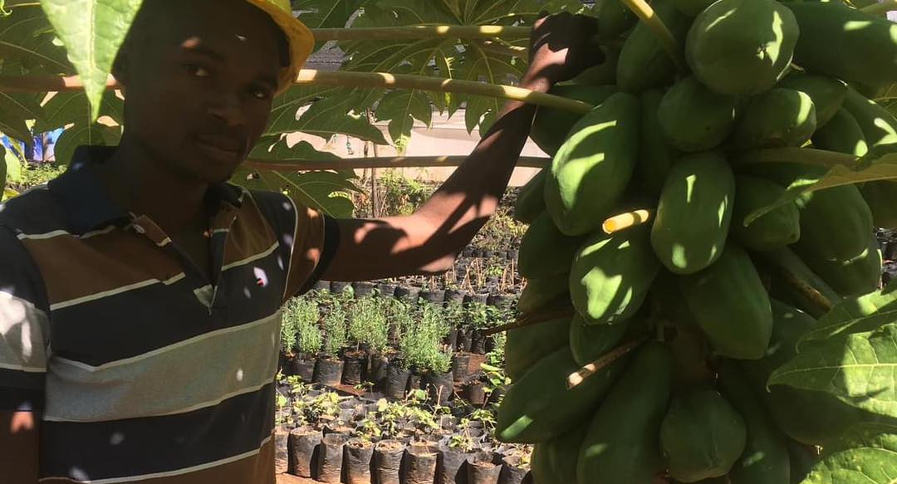
Unbelivable Results

Slide 22
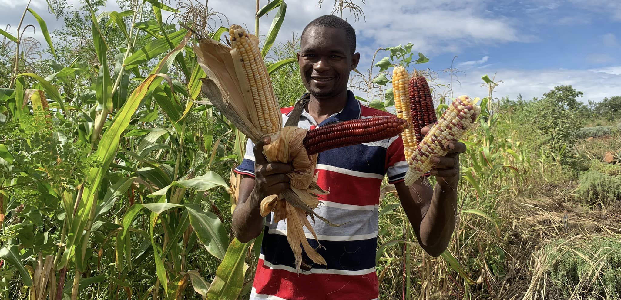
Unbelivable Results

Slide 23
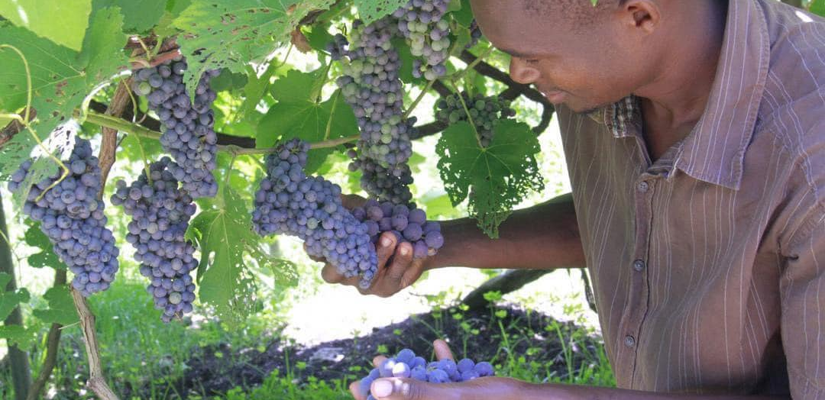
Unbelivable Results

Slide 24
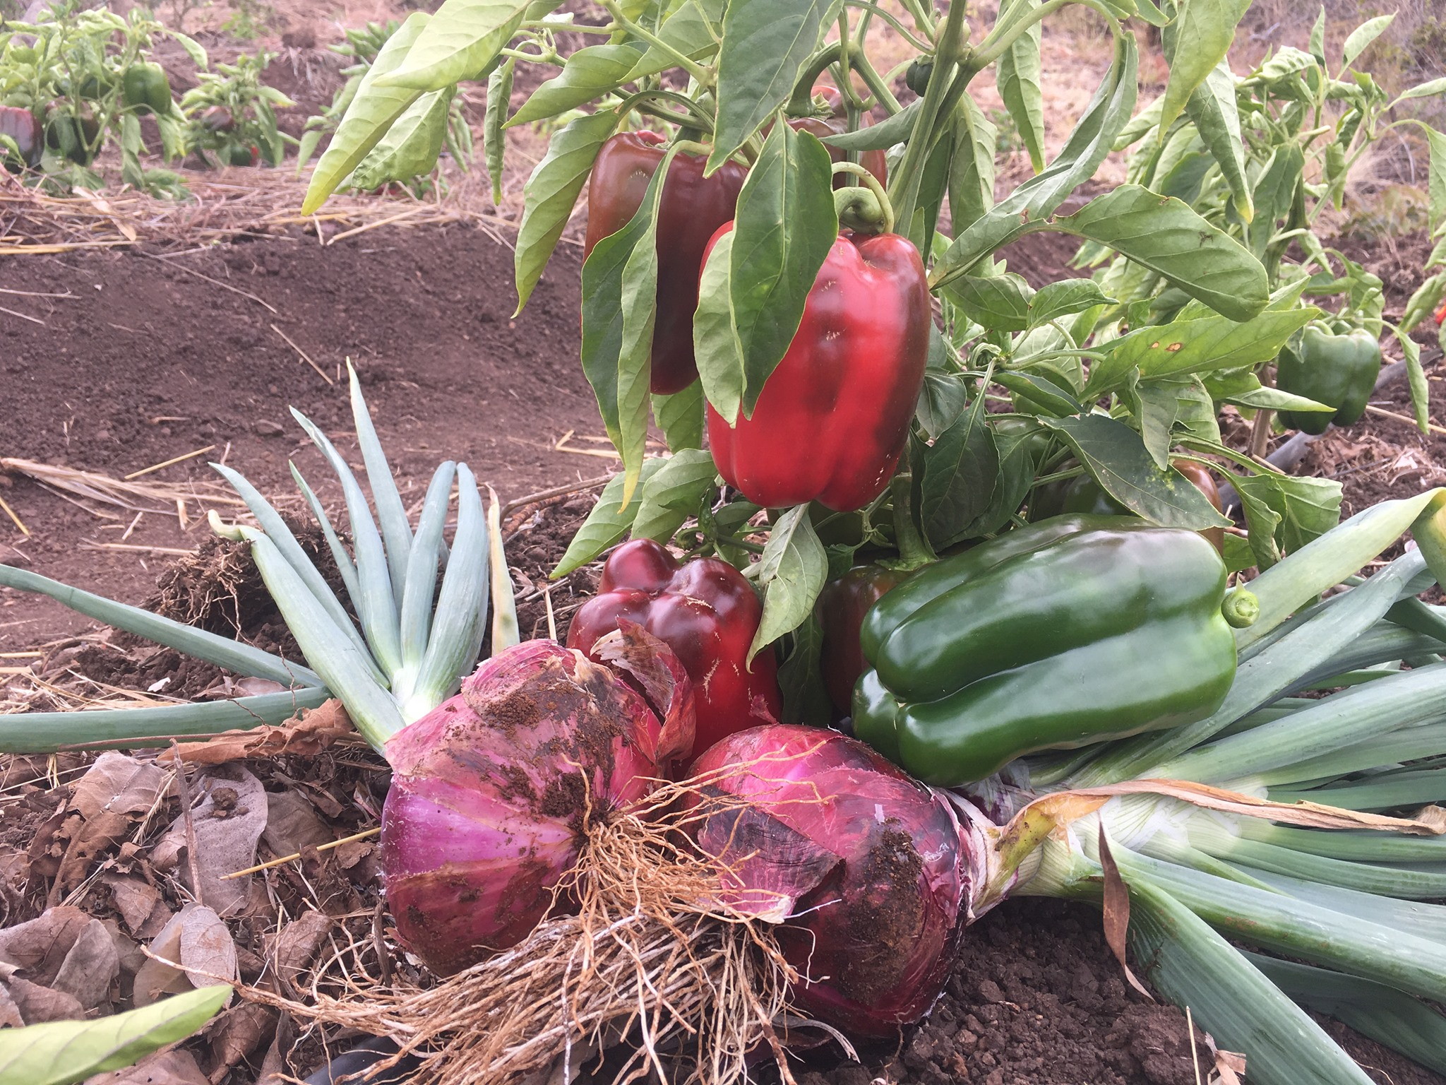
Unbelivable Results

Slide 25
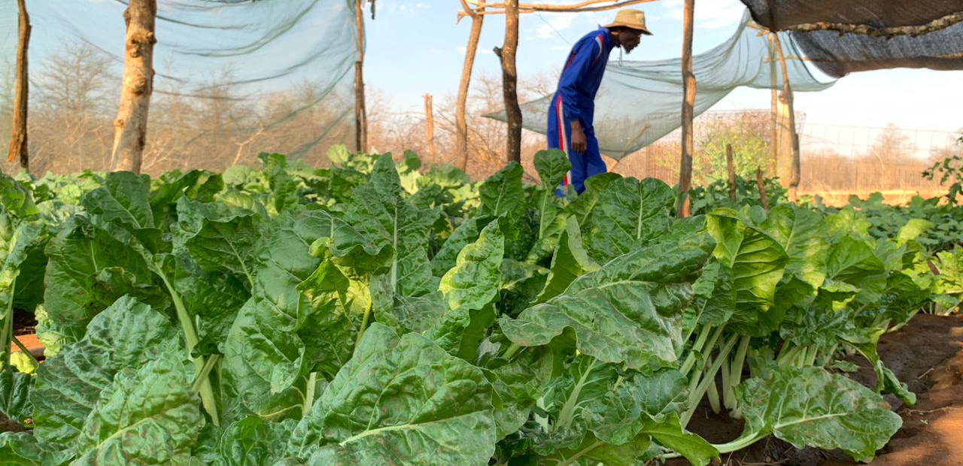
Unbelivable Results

Slide 26
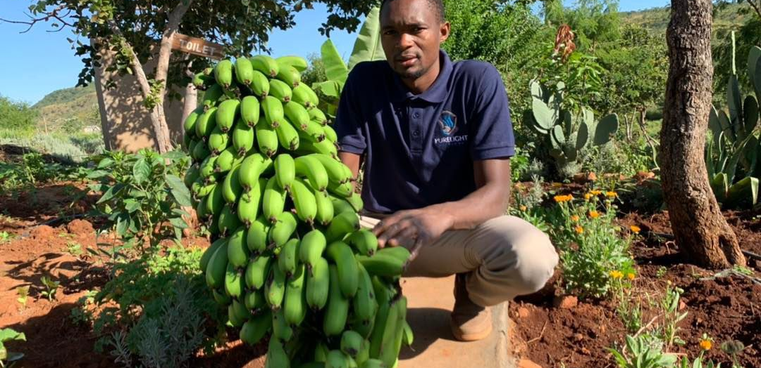
Unbelivable Results

Slide 27
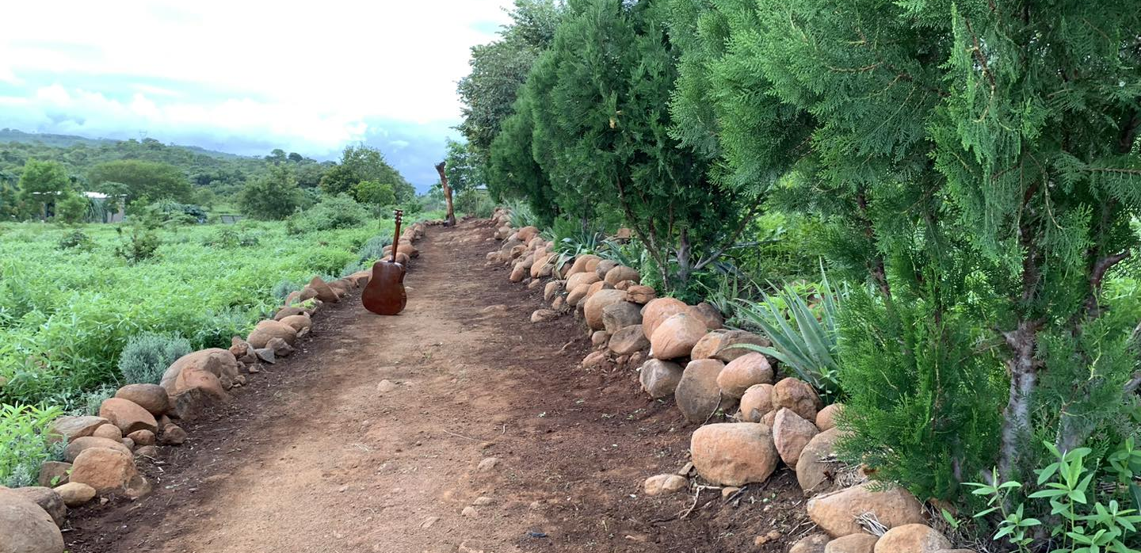
Unbelivable Results

Slide 28
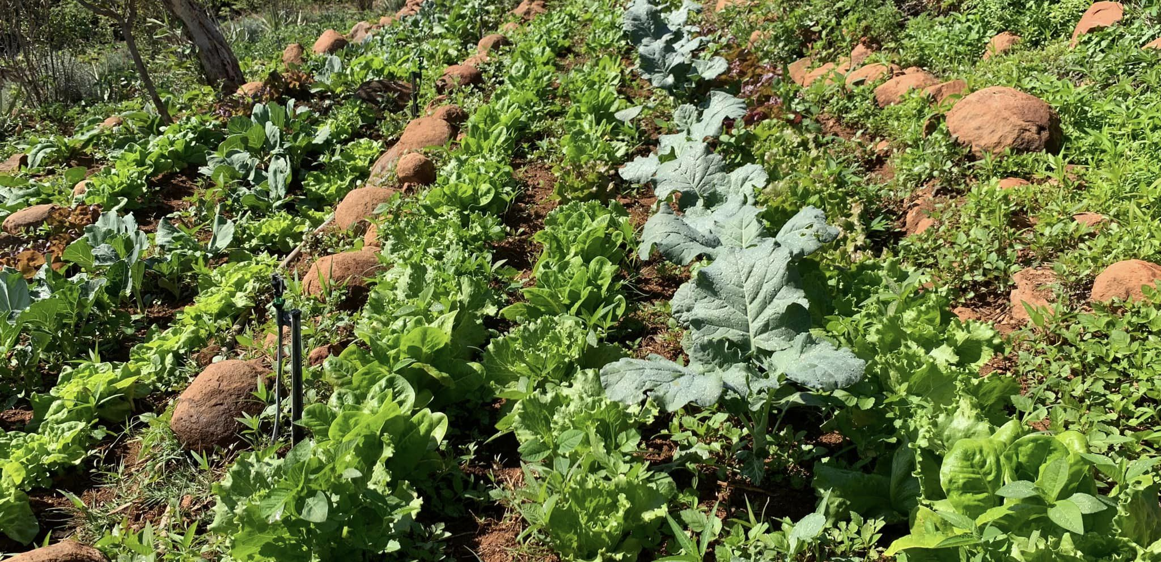
Unbelivable Results

Slide 29
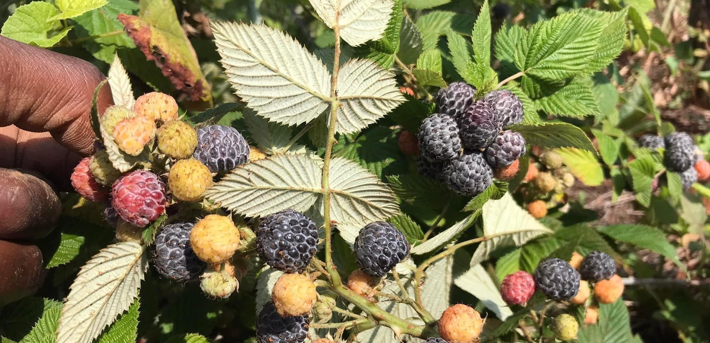
Unbelivable Results

Slide 30
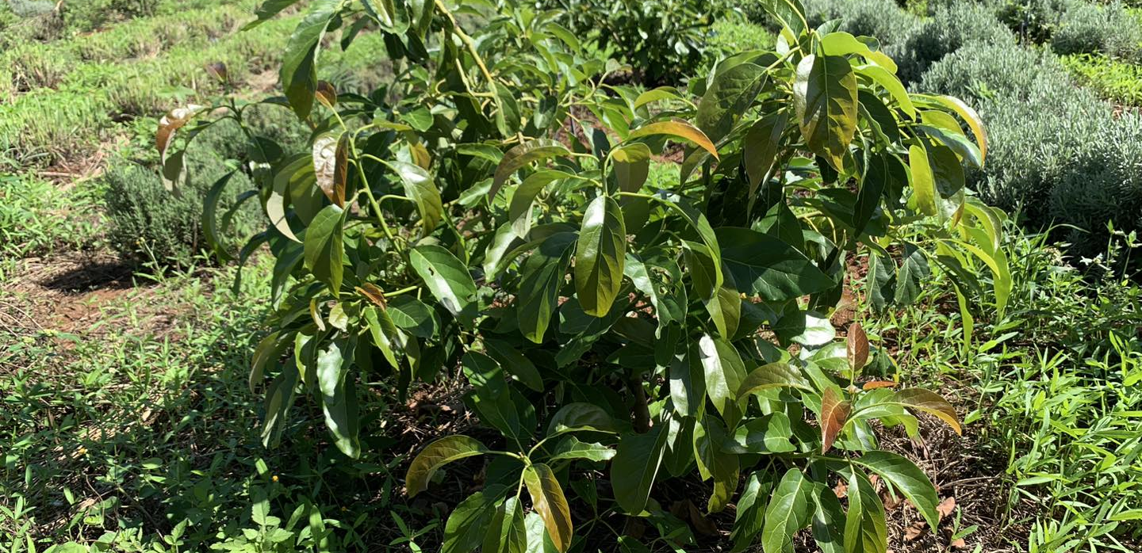
Unbelivable Results

Slide 31
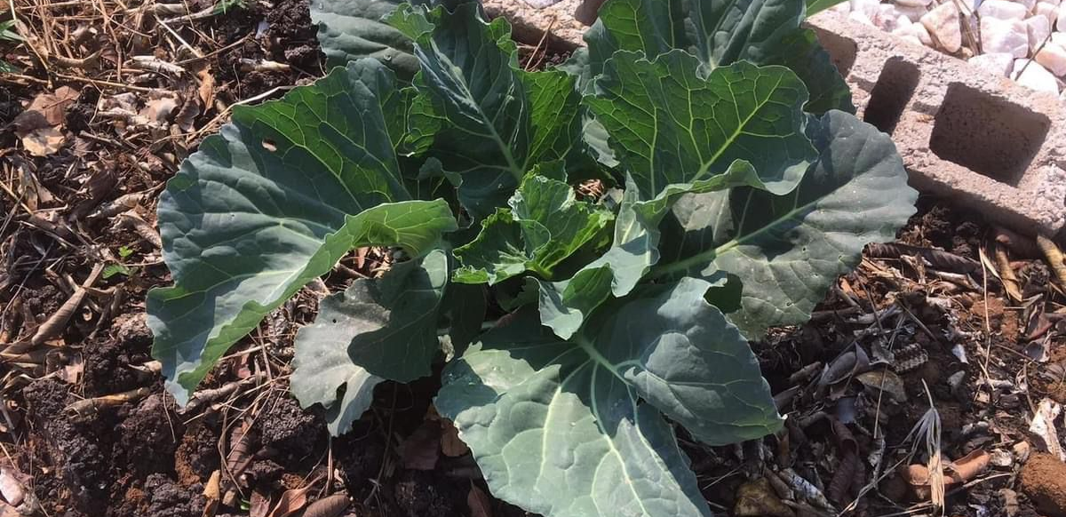
Unbelivable Results

Slide 32
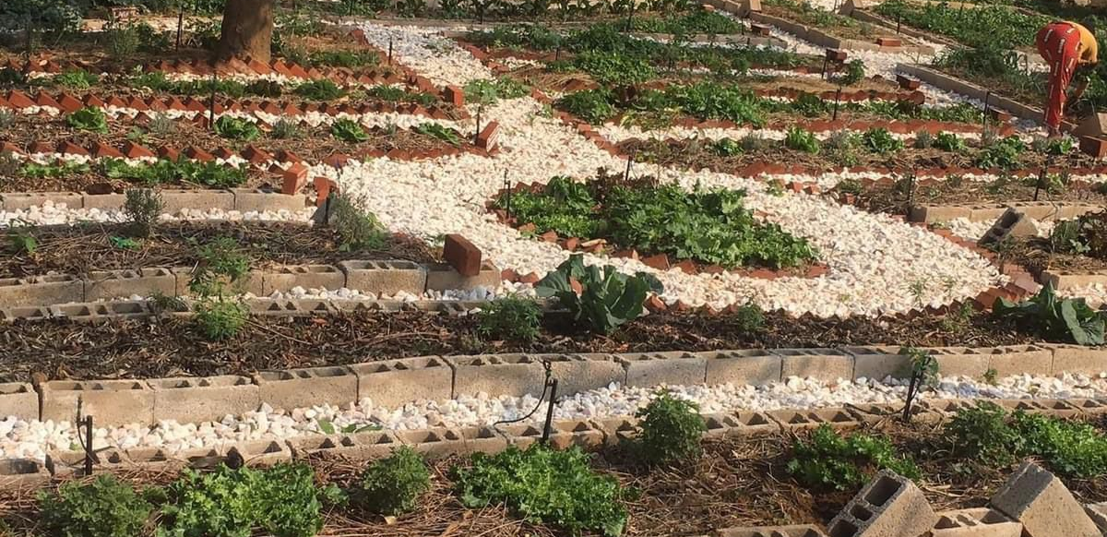
Unbelivable Results

Slide 33
Unbelivable Results

Slide 34
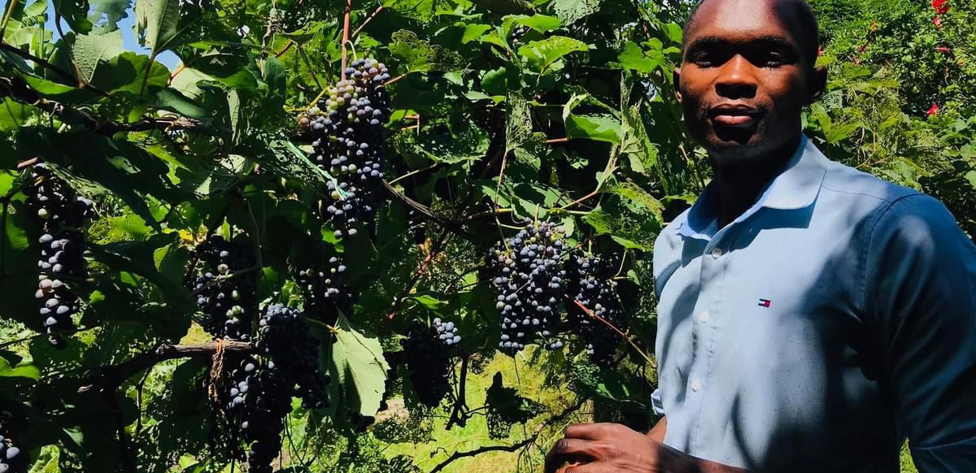
Unbelivable Results

Slide 35
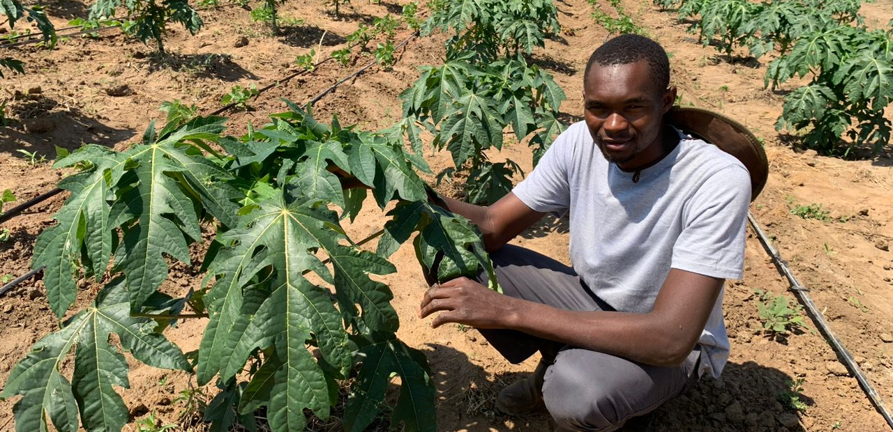
Unbelivable Results Large Scale

Slide 36
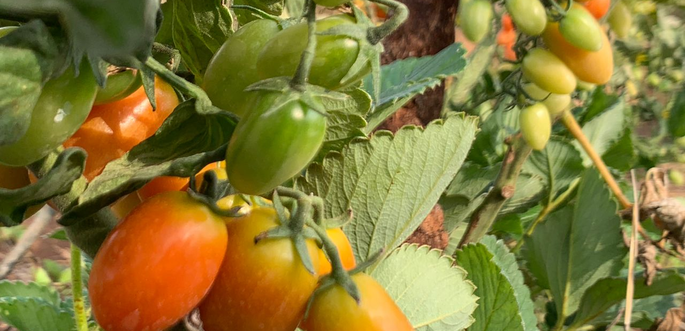
Unbelivable Results

Slide 37
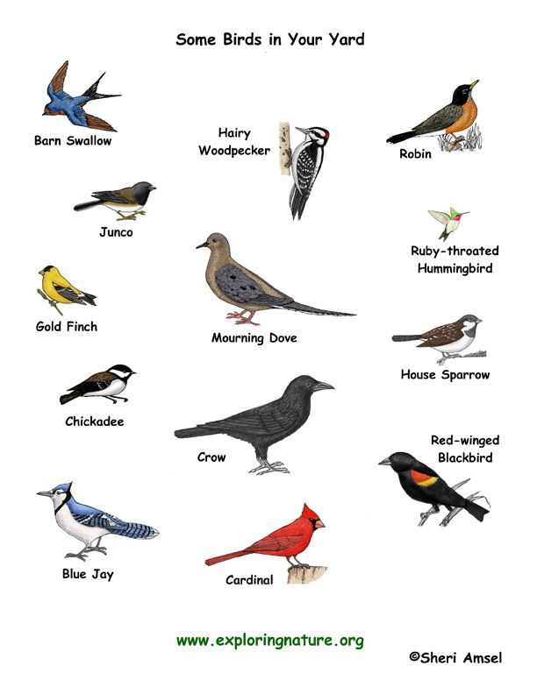
Sweet Home
Birds, Lizards, Snakes, Insects

Slide 38
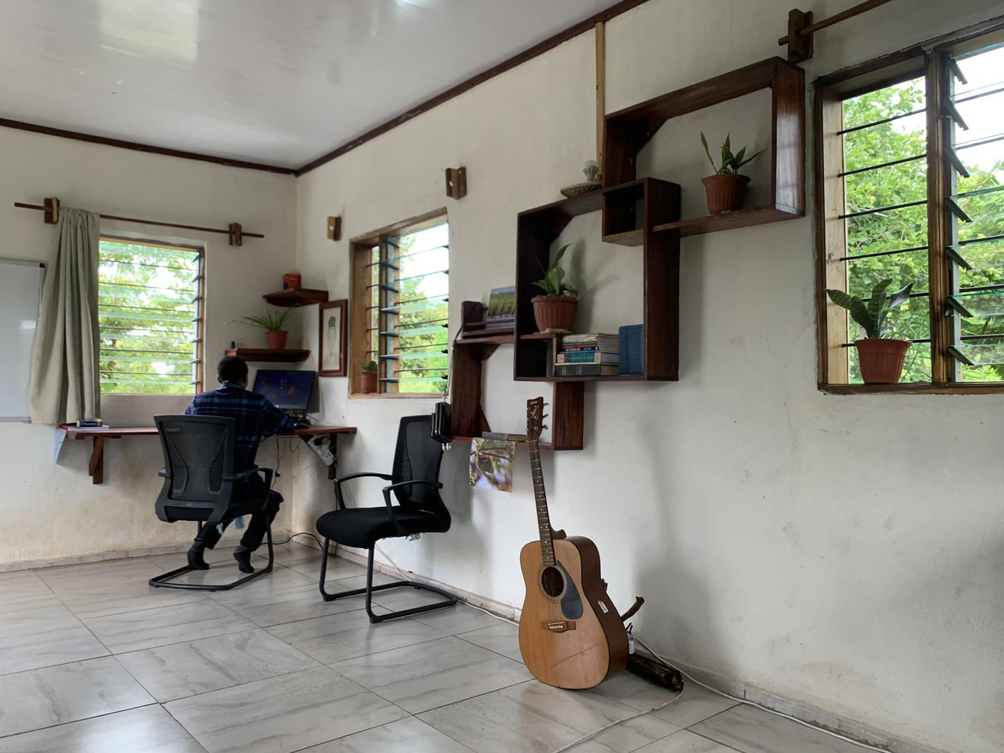
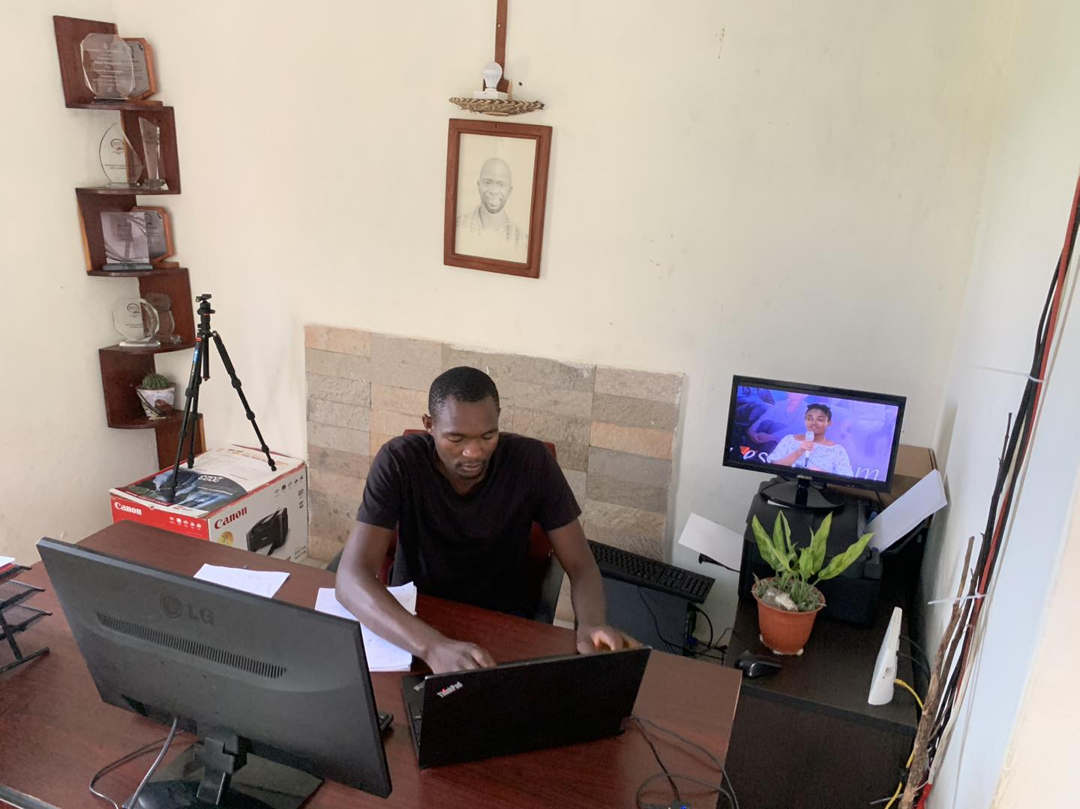

Slide 39
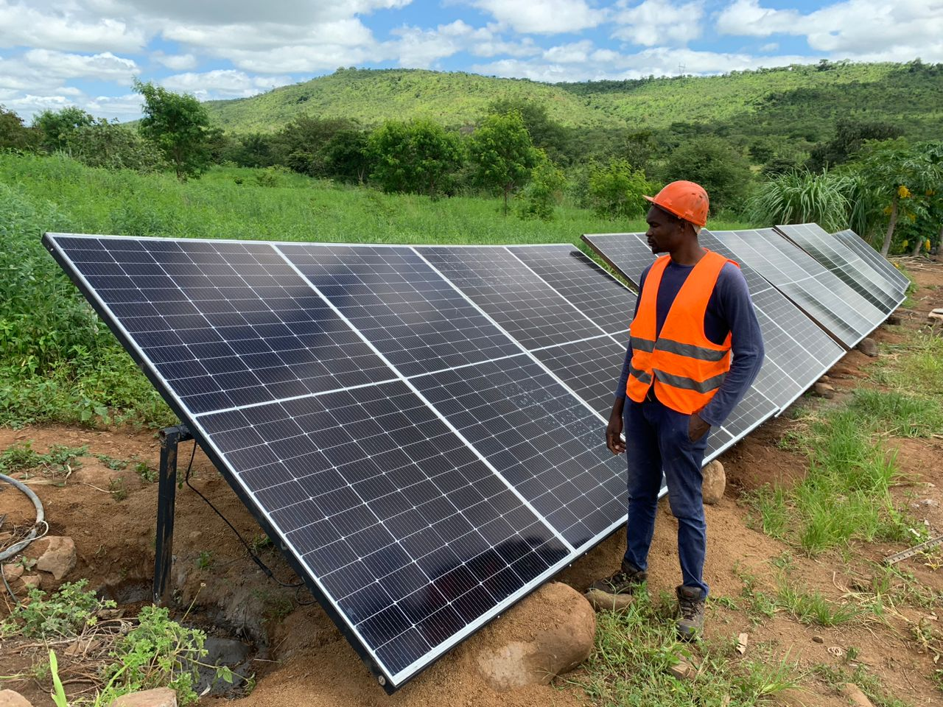

Slide 40
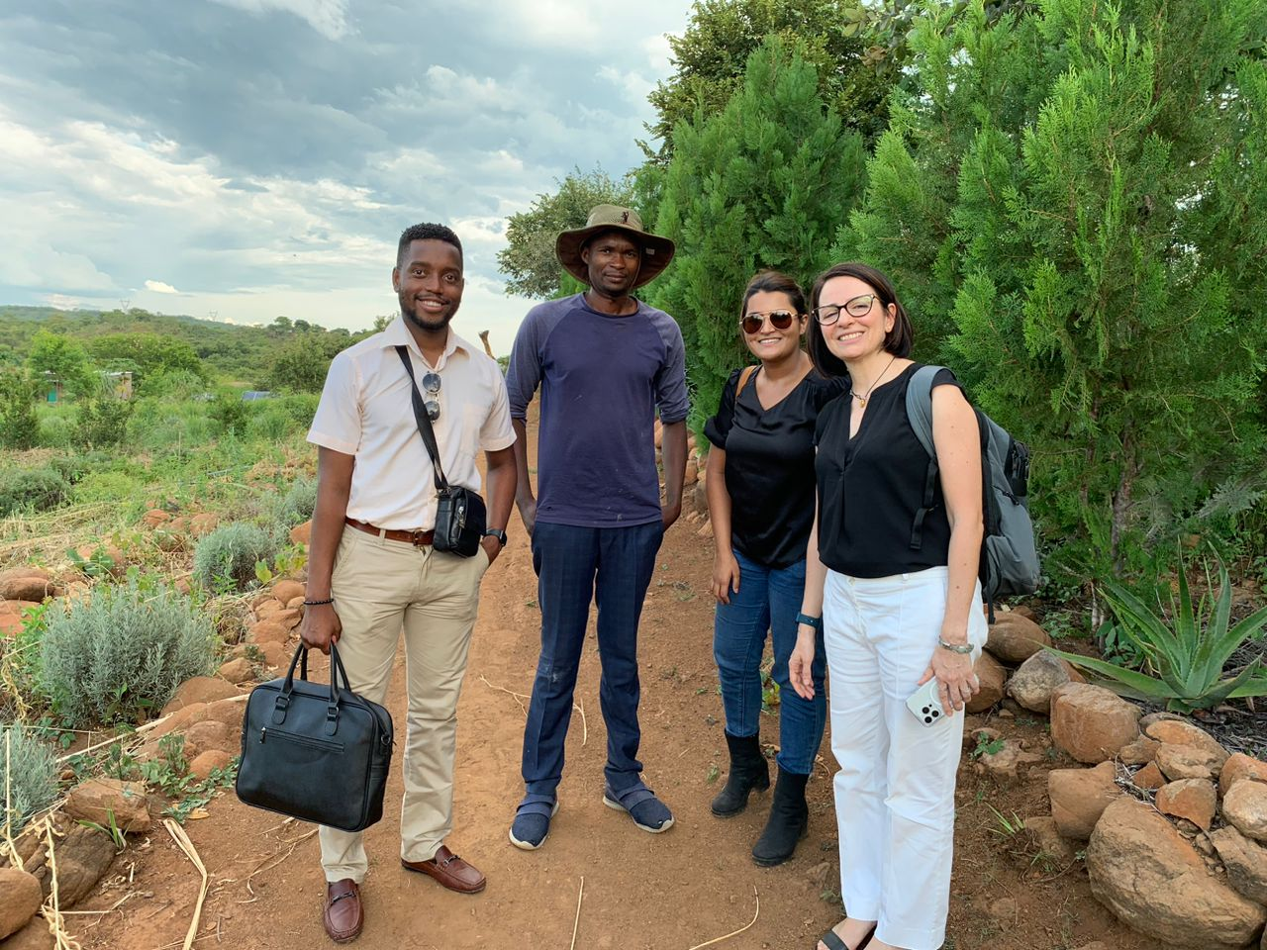

Slide 41
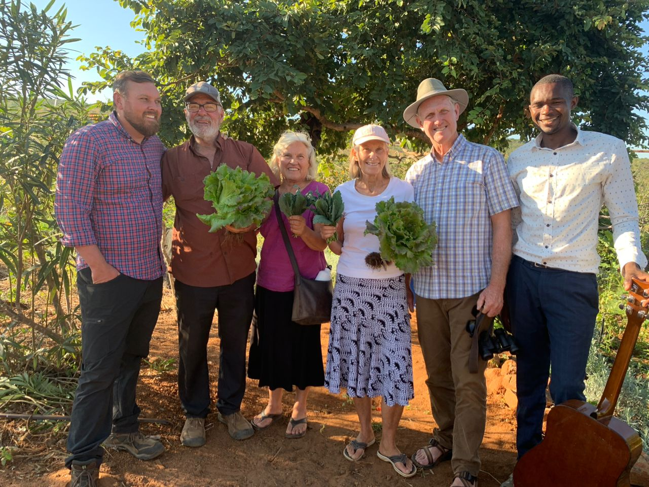

Slide 42
The Most Taste Food

Slide 43
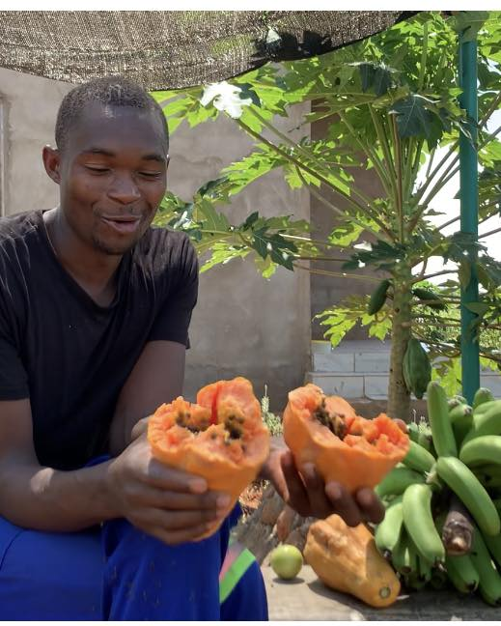
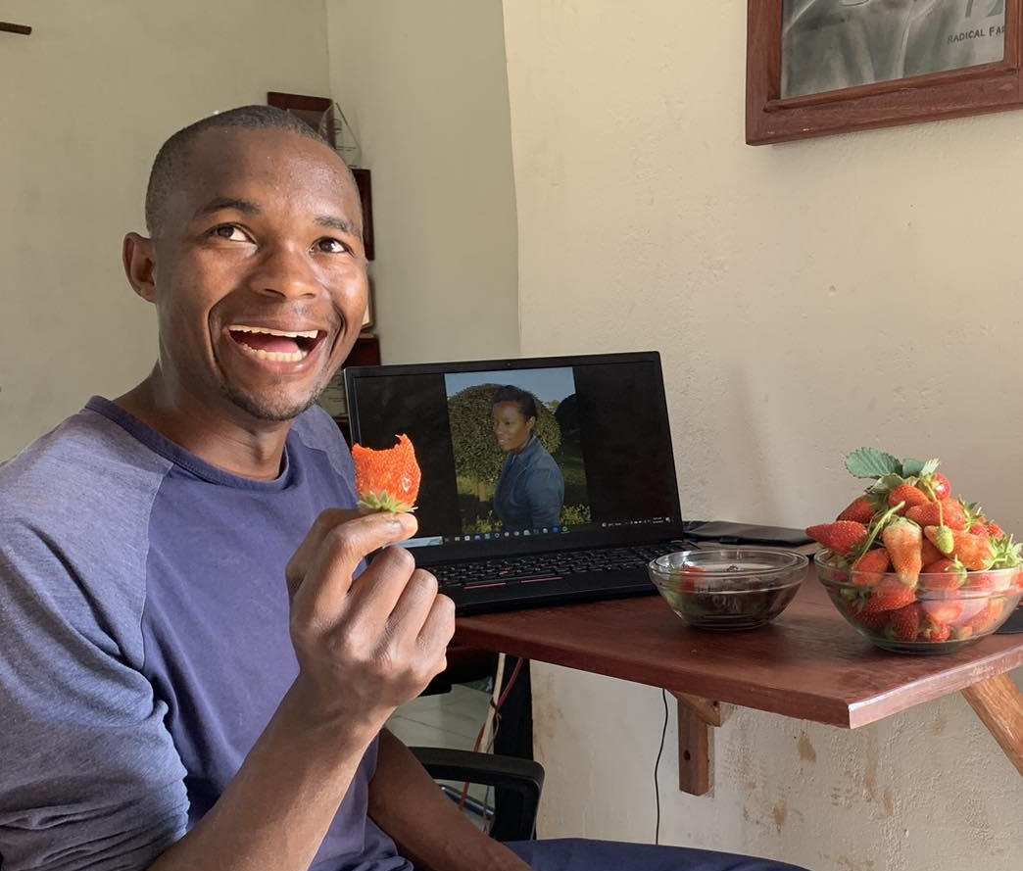
The Most Taste Food

Slide 44
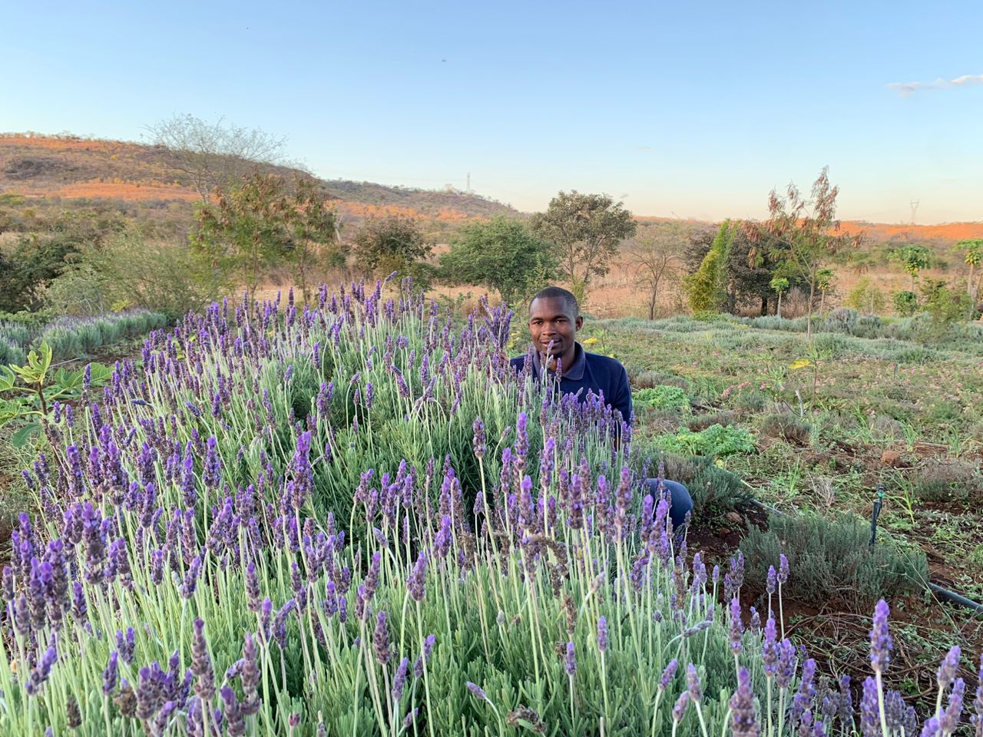
Theurapeutic Aroma

Slide 45
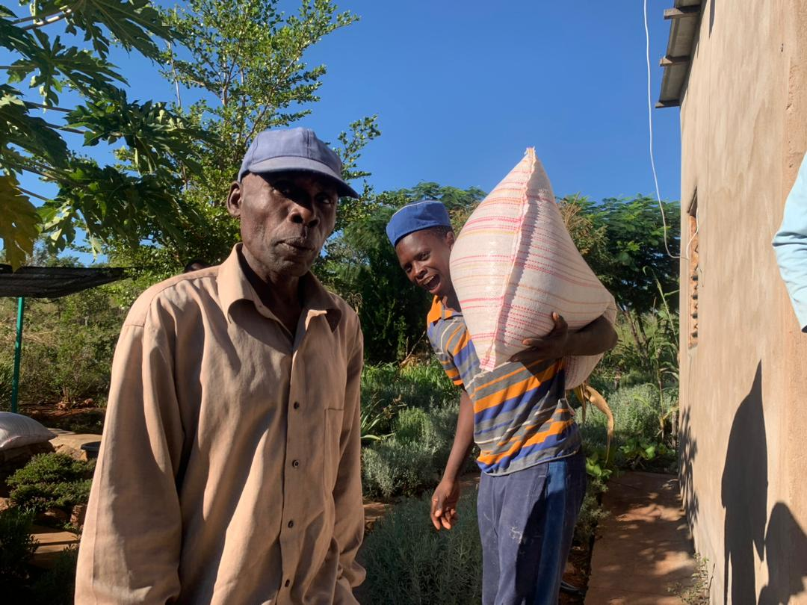
Feeding 50 House Holds

Slide 46
Follow on Social Media
Facebook & Youtube: Radical Farmer
Call: +260973018391
Email: info@orgnic farm7.com
Website: www.organicfarm7.com

